Slide 1
Report Structure
Index/Contents/Intent
List of Abbreviations
List of Figures
List of Graphs
List of Tables
and List of if any other inclusion
INTRODUCTION
LITERATURE SURVEY
SYSTEM DEVELOPMENT
PERFORMANCE ANALYSIS
CONCLUSIONS
References
Appendices
Acknowledgement

Slide 2
1. INTRODUCTION (5-10 Pages)
1. INTRODUCTION (5-10 Pages)
1.1 Introduction
1.2 Necessity
1.3 Objectives
1.4 Theme
1.5 Organization

Slide 3
2. LITERATURE SURVEY(15-50 Pages)
Literature Survey
Related information available in standard Books, Journals, Transactions, Internet Websites etc. till date (More emphasis on last three to five years)

Slide 4
3. SYSTEM DEVELOPMENT (15-50 Pages)
Model Development
Analytical
Computational
Experimental
Mathematical
Statistical
(Out of above methods at least one method is to be used for the model development)
Some mathematical treatment or related information is required

Slide 5
4. PERFORMANCE ANALYSIS(25-50 Pages)
Analysis of system developed either by at least two methods depending upon depth of standard
These methods normally used are Analytical /Computational/Statistical/Experimental/ or Mathematical
Results at various stages may be compared with various inputs
Output at various stages with same waveforms or signals or related information/parameters
Comparison of above results by at least two methods
justification for the differences or error

Slide 6
5. CONCLUSIONS (1-3 Pages)
5.1 Conclusions
5.2 Future Scope
5.3 Applications/Utility

Slide 7
Contributions (if any, 1 Page)
The innovative work/invention/new ideas generated from the analysis of the work which can be taken from the conclusions. If possible patent may be filed depending upon the level of research or contributory work.

Slide 8
References
Author, “Title”, Name of Journal/Transactions/ Book, Edition/Volume, Publisher, Year of Publication, pp.__.
These references must be reflected in text at appropriate places in square bracket.
In case of web pages complete web page address with assessing date has to be enlisted.
List of references should be as per use in the text of the report.

Slide 9
Appendices ^{(1-25 Pages)}
Related data or specifications or referred charts, details computer code/program, etc.

Slide 10
Acknowledgement (1 Page)
Expression of gratitude and thankfulness for helping in completion of the said task with name
Signed by the candidate

Slide 11
General Guidelines
Text should be printed on front and correct side of the watermark on quality bond paper
Paper size- A4, 75 to 85 gsm paper
Left Margin-1.5”
Right Margin-1/2”
Top Margin-1”
Bottom Margin-1”
Text Width 6”

Slide 12
Page Numbers
First page of first chapter need not be printed anywhere
Second page onwards at right hand corner at ½ inch from right and top side
From second chapter onwards starting page number of chapter should be printed at bottom center place
Undergraduate report total pages –around 70-100
Postgraduate Dissertation total pages –around 80-150
Ph. D. Thesis total pages –around 100-250

Slide 13
Language
Follow American English
Example
  Fulfilment
  Traveling
  Meter
  Preferably use ‘LATEX’ software for writing
All Greek words must be italic for example e. g., etc., i.e., et al.
Continued…….

Slide 14

Report Heading -All Capital—16 Font
Chapter heading -All Capital—14 Font
Subchapter –title case-12 Font
Sub-Subchapter –First Alphabet Capital case-12 Font
Page numbers for Index/Contents/Intent should be in roman
Title of the Report should not be more than two lines
Text pages should be in times new roman
The page of the Index/Contents/Intent heading should be below the words for appropriate sub chapter or sub-sub chapter as shown in sample copy
Cover page should have (Mission statement of Institute) in inverted commas, Symbol of Institute, Name of Department, and Institute

Slide 15
Binding
Black color, golden screen printed or embossed
Width of report should have front side degree-B. E. /M. E. /Ph. D. with appropriate branch in bracket
Central place for Title and lower place for year of submission [B. E. ]
Central place for name of Student/Research Scholar [M. E. /Ph. D. ]

Slide 16
Flap
Suitable flap with name of the candidate, Department and Institute name and symbol can be used with nylon strip

Slide 17
Inclusion
Ph. D. Thesis should contain the pages in following regard
  Abstract, Synopsis, and Statement of originality at the start
  Summery sheet followed by contributions
  List of related publications
M. E. Dissertation should contain the pages in following regard
  Certificate, Statement of originality followed by Abstract
  Dissertation approval sheet
  List of related publications

Slide 18
Sample (Side)
(Report)
(Dissertation)
(Thesis )
1”
1”
1”
B. E. (E)
M. E. (E)
Ph. D. (E)
Title
Name
Name
Golden Color Strips
Golden Color Strips
1”
2007-08
1”
2007-08
1”
2007-08

Slide 19

Sample (Cover)

Slide 20

Sample (Certificate)

Slide 21
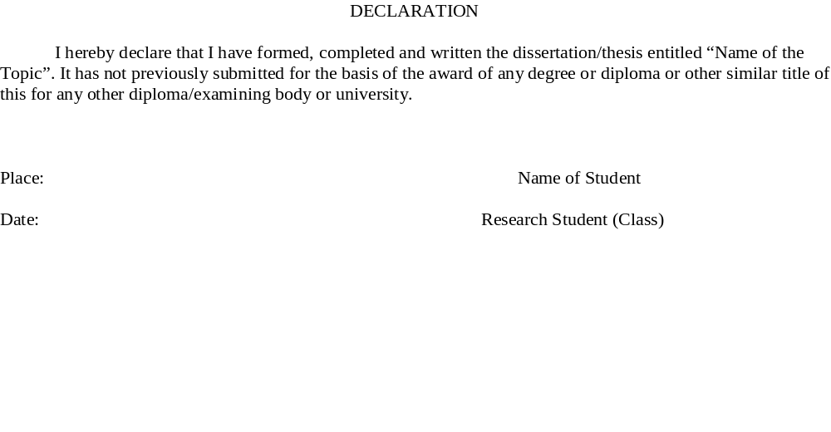
Sample (Declaration/ Statement of Originality)

Slide 22
Note:
For every interview it is necessary/must to carry the report. It will give bread and butter for future.
For more information and sample of hard copy please contact the respective Head of the Department.

Slide 23

Thank You

